Slide 1
First Lesson
Expectations – lining up and entering the room
Equipment

Slide 2




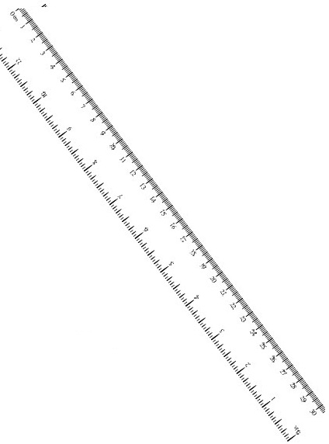
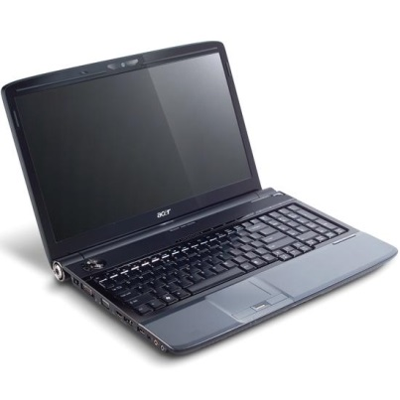
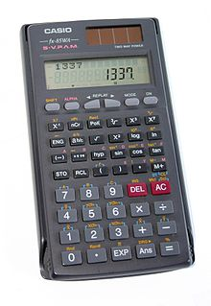

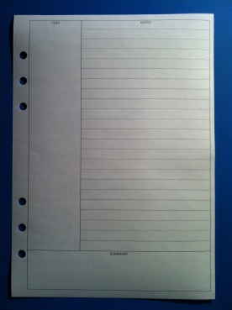
Equipment
Paper
Avid Binder
Pencils
Pens
PC or ipad
Ruler
Calculator
Interactive notebook

Slide 3


First Lesson
Expectations – lining up and entering the room
Equipment
BYOD
Connect S:\AdminShared\All Staff\Learning Areas\Mathematics\Programs\2016\Year 10\Course Info year 10A 2016 - Baldivis.docx S:\AdminShared\All Staff\Learning Areas\Mathematics\Programs\2016\Year 10\Year 10A Mathematics Program Outline 2016 Student.docx
PC or ipad

Slide 4
First Lesson
Expectations – lining up and entering the room
Equipment
BYOD
Connect
Expectations – Work and behaviour(Classroom rules to allow everyone to learn)
Homework

Slide 5









My Algebra Interactive Notebook
$$×$$
$$\frac{1}{2}$$
$$÷$$
$$+$$
$$−$$
$$\frac{3}{5}$$
$$7$$
Name
Class
Teacher
Term 1 Semester 1
$$5^{2}$$
$$\sqrt{9}$$
1

Slide 6
Create your own front page
It needs to contain the following –
My number interactive notebook
Your name
Class 10 Maths 1
Teachers Name – Mr McAllister
Semester 1 Term 1
Page number 1

Slide 7
Contents
Glossary or Formula Page
Page
Date
Description
2
3

Slide 8
Tasks
24
7
30
Essential Question
Questions
Notes
Summary
4
5

Slide 9
24
7
30
Date
Title
EQ –
5

Slide 10
Questions

Slide 11
Notes Review
24, 7 ,30
Date
Title
Essential question
Notes complete
Notes complete with colour and diagrams
Questions completed
Contents page filed in
Formula page filled in

Slide 12
Homework
Naplan Practice
Review your notes and write a summary answering the essential question.

